Slide 1
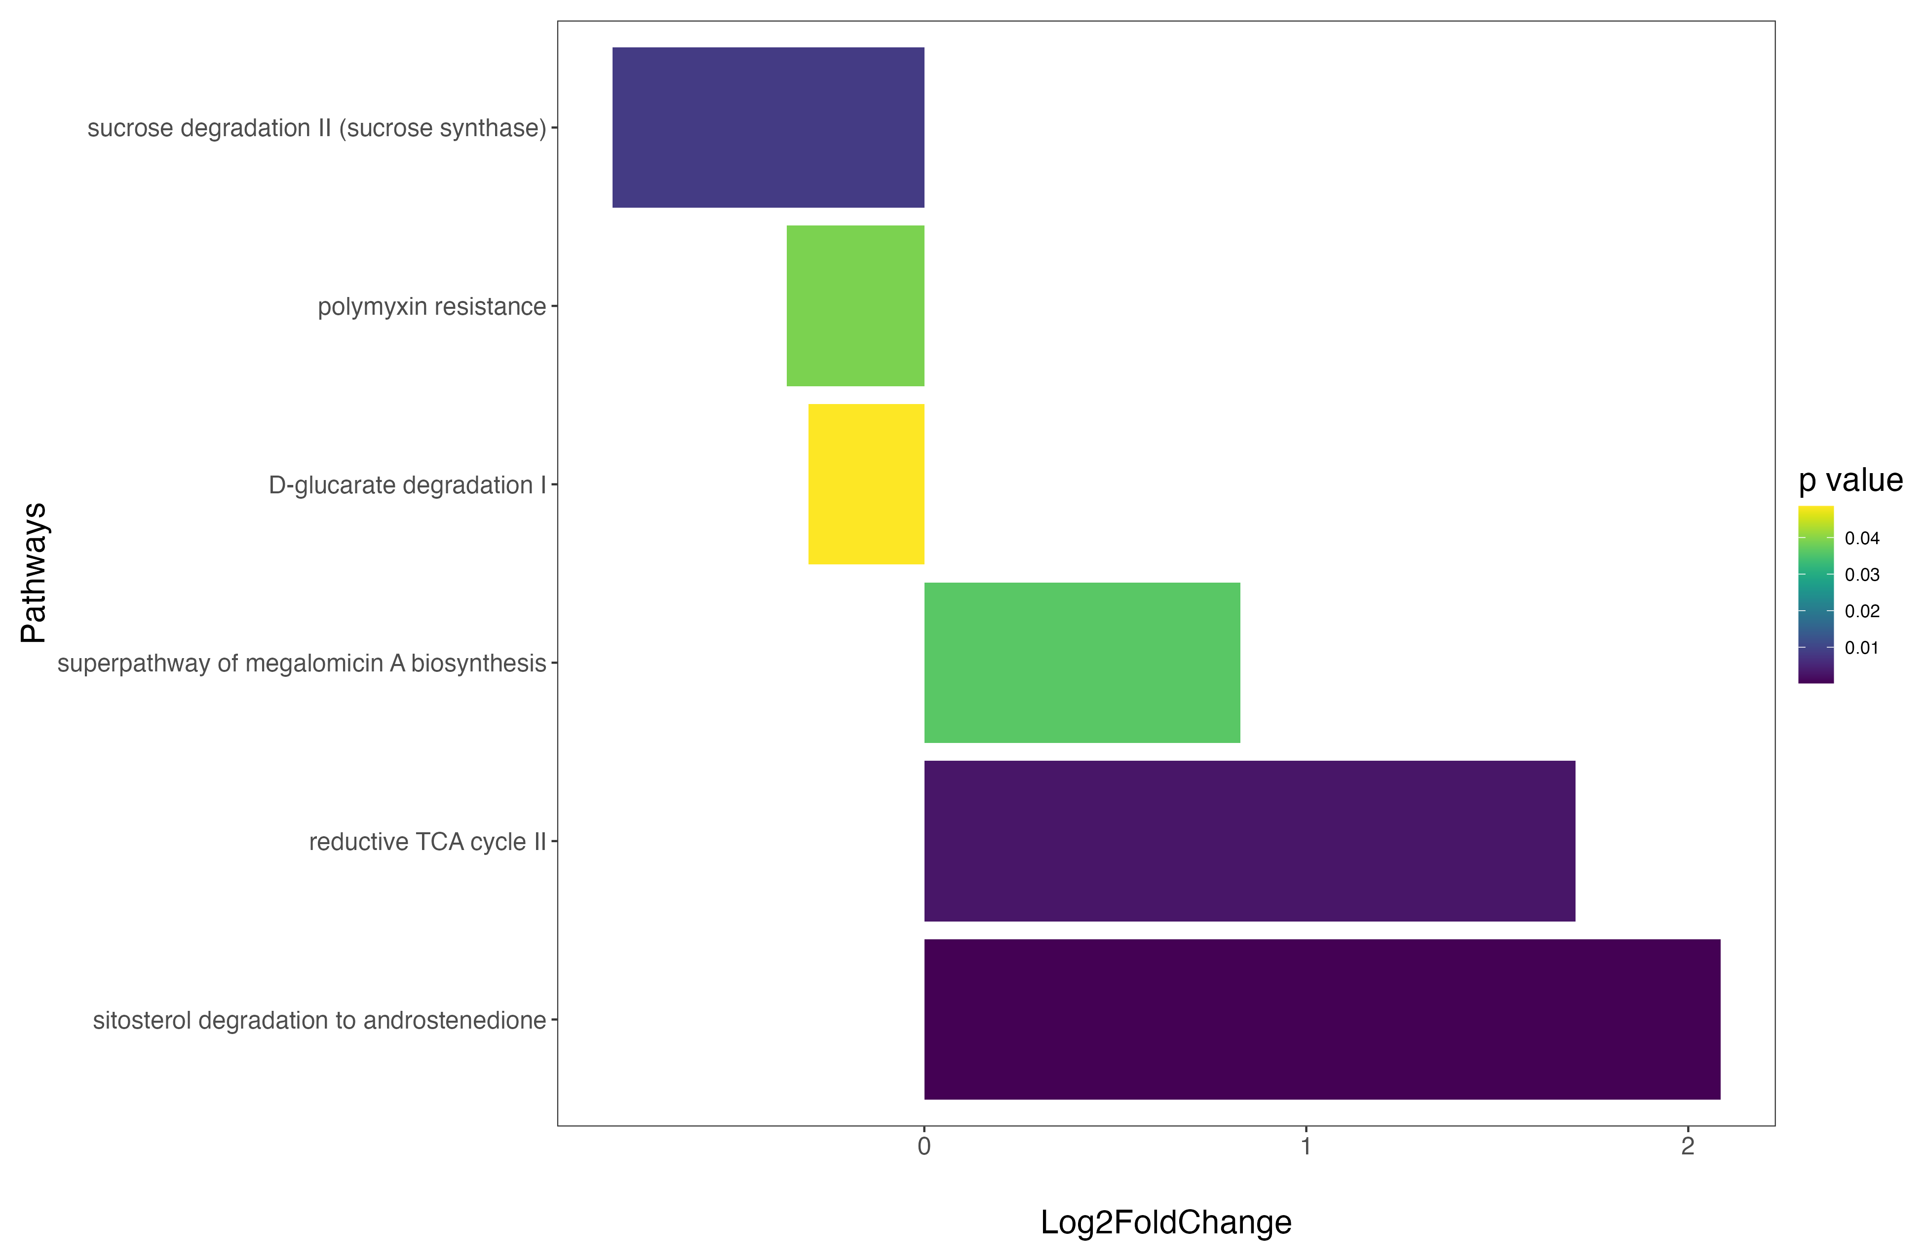
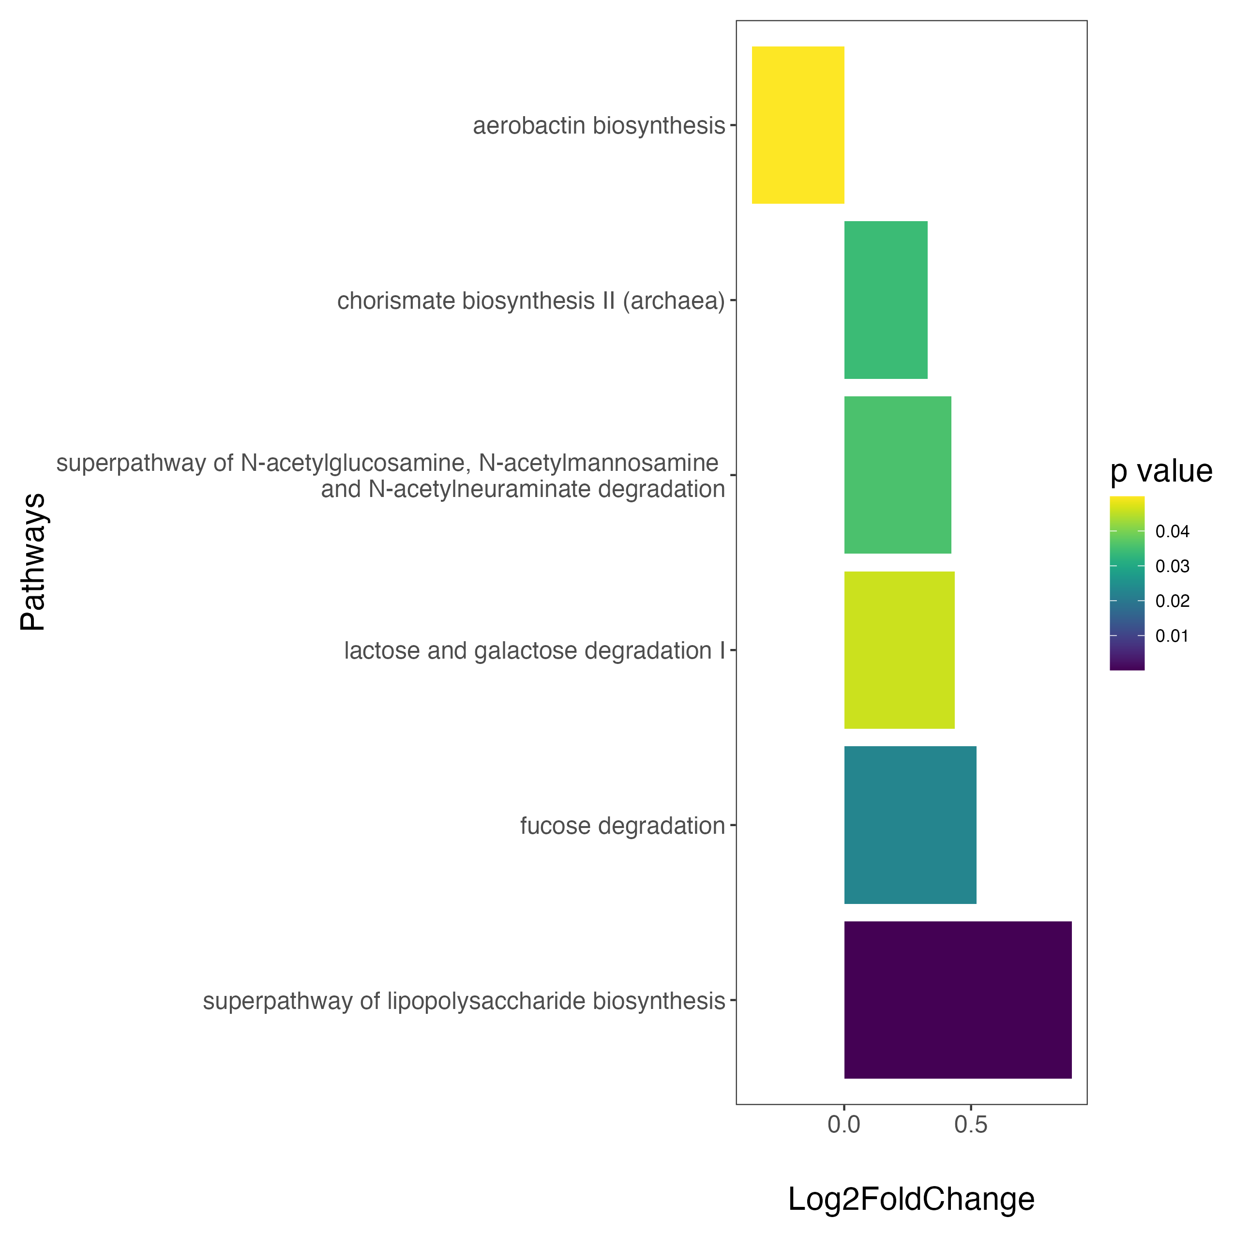
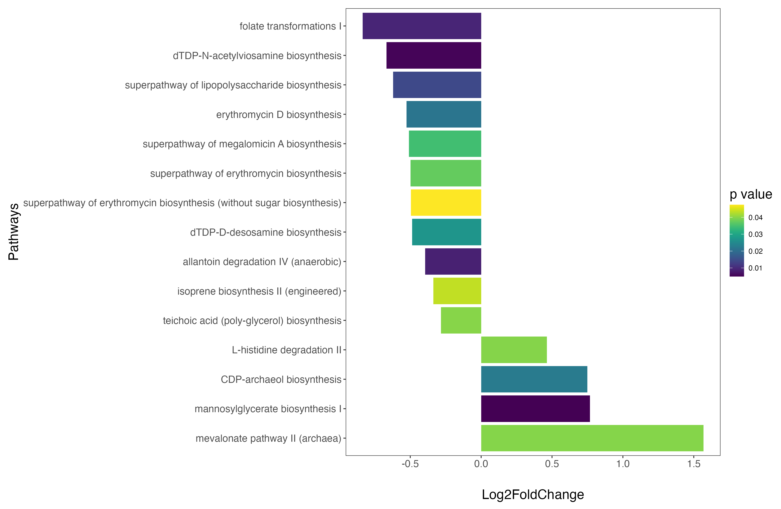
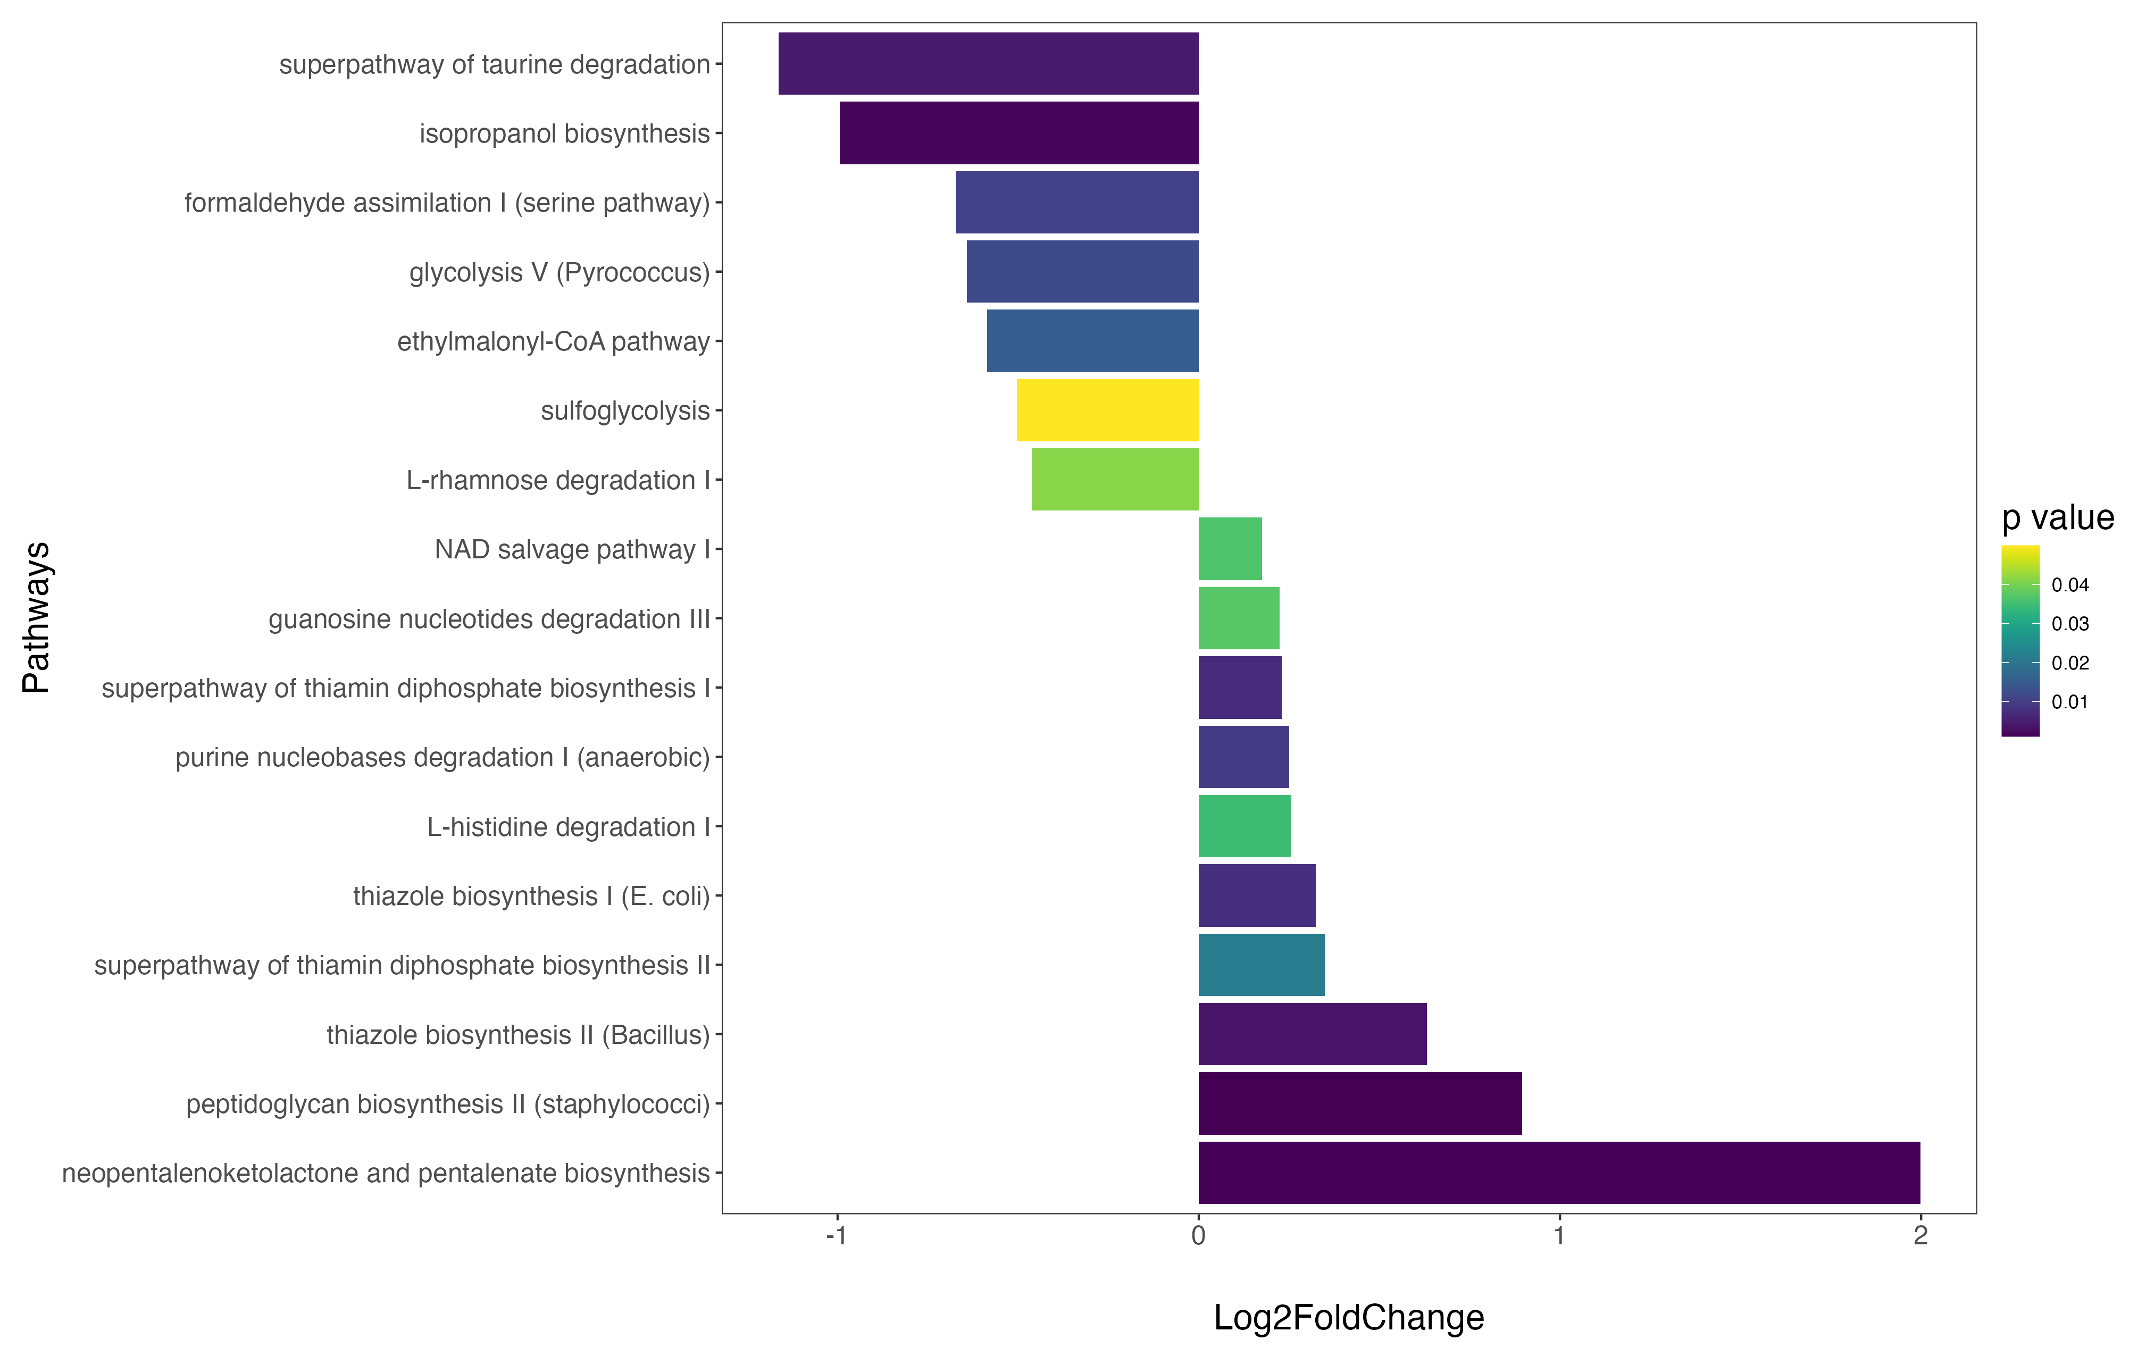
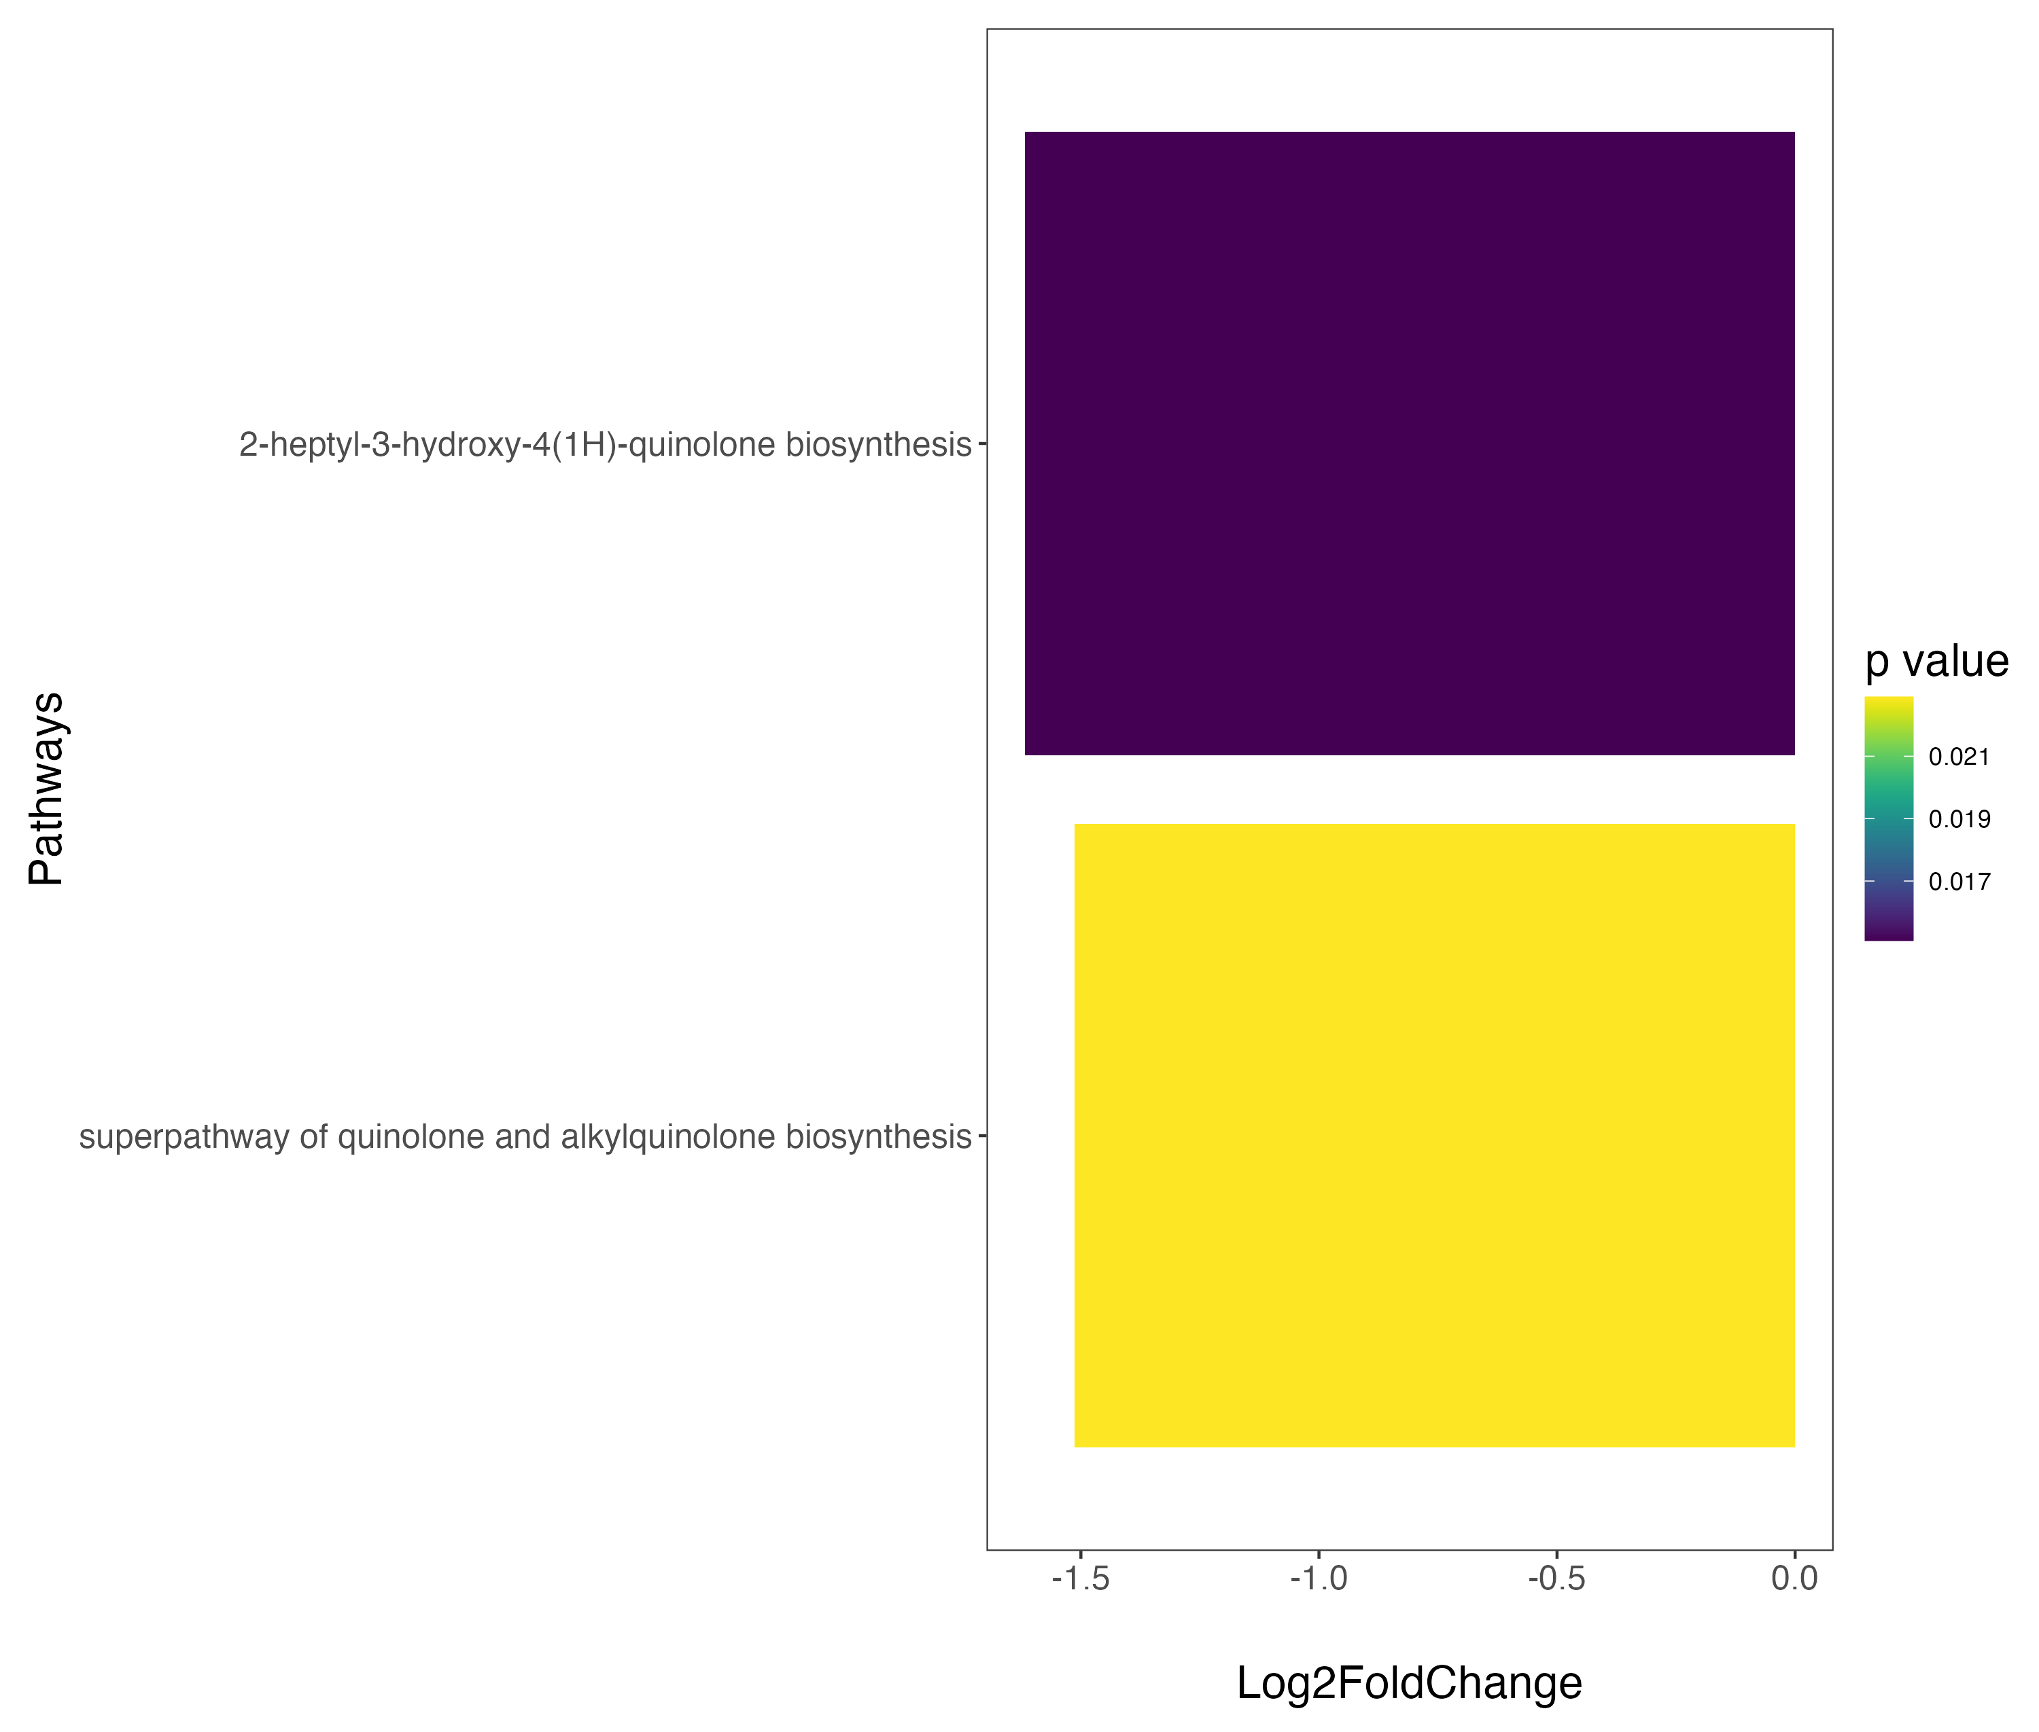
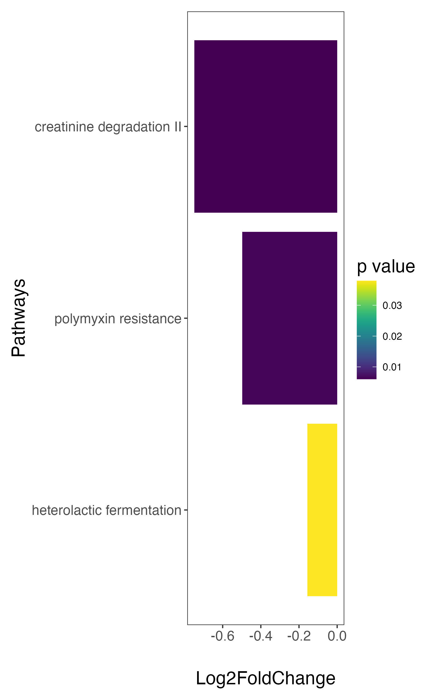
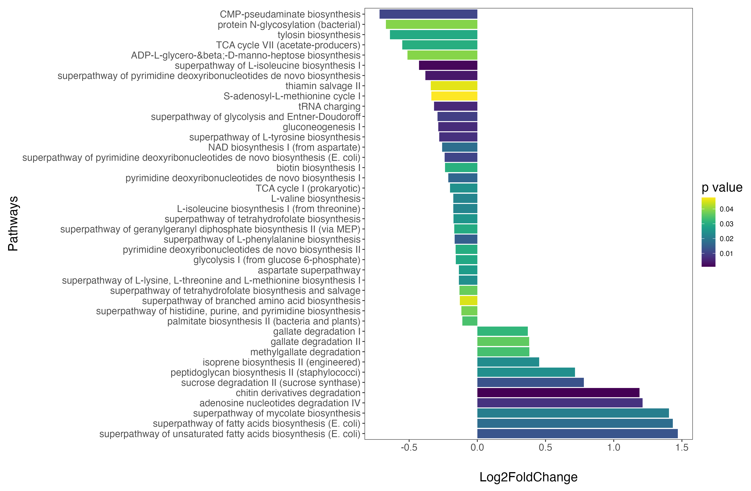
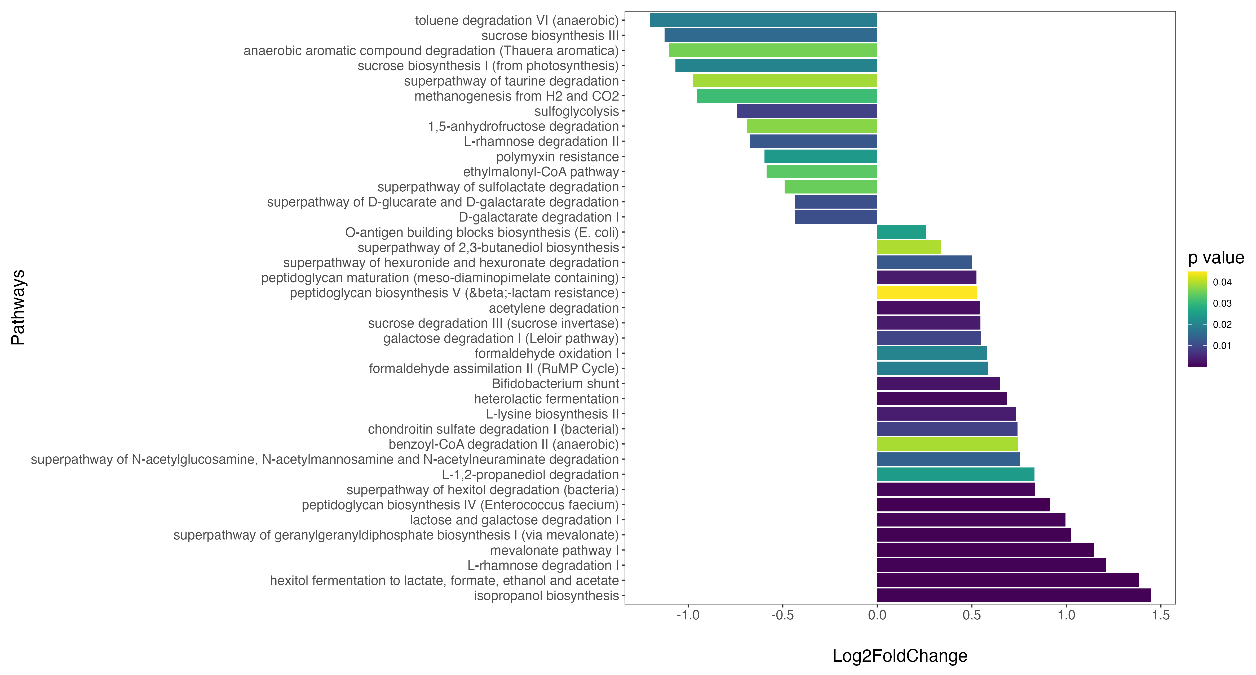
A
Chronic gastritis
Intestinal metaplasia
Intraepithelial neoplasia
Gastric cancer
down-represented in H. pylori positive
up-represented in H. pylori positive
down-represented in H. pylori positive
up-represented in H. pylori positive
down-represented in H. pylori positive
up-represented in H. pylori positive
down-represented in H. pylori positive
up-represented in H. pylori positive
B
down-represented in Fusobacterium low
down-represented in Fusobacterium low
down-represented in Fusobacterium low
up-represented in Fusobacterium low
down-represented in Fusobacterium low
up-represented in Fusobacterium low

